Slide 1

Introduction to Database Systems
DBS211
Application Architecture & Design, ERDs

Slide 2
Week 8
Application Modeling & Design, ERDs
Lab 6 due Monday July 8th @ 11:59pm
Quiz 6 (Transactions) opens Saturday July 6th at 8am, closes Monday July 8th at 11:59pm
Lab 7 is due Monday July 15th @ 11:59pm
Quiz 7 (Data Modeling & ERDs) will take place in Tuesday’s class.

Slide 3
Conceptual Database Modeling
Data Modeling – the process of following a series of steps to conceptually design a database schema and developing a graphical representation of the database design
Data modelling is a first step in the process of database design
The aim is to describe:
The data in the database
The relationships between the data
The constraints on the data
In the second step, the data items, relationships, and constraints are all expressed using concepts provided in the high-level model
Designing the database is the third step is database implementation and operators/user interface build

Slide 4
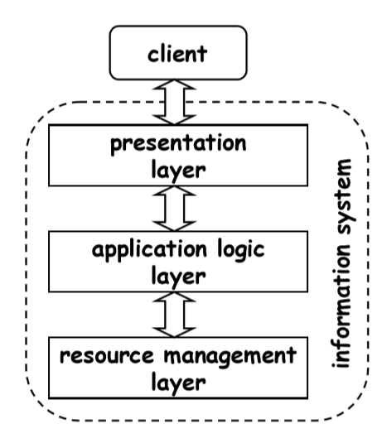
Application Layers - Introduction
Layered Architecture – a structural layout separating the system into different levels that are in charge of carrying out particular tasks
There are 3 layers:
Presentation layer/User Interface/View Layer
Business Logic/Application Logic
Resources Management/Data Access/Model Layer
Each layer interacts with the layers above and below
The creation of complex applications depends greatly on software architecture

Slide 5
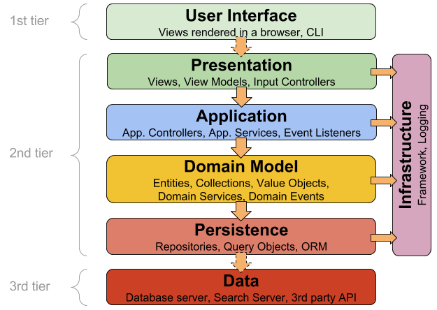
Application Layers - Introduction

Slide 6
The User Interface Layer
Definition: The UI layer allows user interaction with the system and provides visual feedback.
Role: Bridges the user and system functionality, ensuring an intuitive and user-friendly experience.
Key Components:
Graphical User Interface (GUI): Visual elements like buttons, text fields, and drop-down menus.
Navigation: User movement elements such as menus, breadcrumbs, and links.
Feedback: Visual feedback elements like status messages, loading indicators, and error messages.
Input Validation: Ensures correct data input through error messages and form validation.
Design Principles:
Intuitive and Easy to Use: Optimized for user needs.
Based on UI Design Principles and Guidelines: Ensures consistency and usability.
User Testing: Validates that the UI is user-friendly and effective.

Slide 7
The Presentation Layer
The presentation or the user interface provides the user interaction.
Different forms of the presentation layers could be
Web browsers
Mobile phone user interface
Desktop phone applications

Slide 8
The Application/Business Logic/Domain/Data Access Layer
The business or application logic layer provide the high level view and access of data.
In this layer, business rules are enforced.
The Data-Access Layer (DAL) is a component of a software architecture that is responsible for managing the data storage and retrieval of an application.
The DAL is responsible for performing tasks such as:
Connecting to the data storage system and managing the connection.
Generating and executing SQL queries or other data access commands to retrieve and store data.
Mapping the data from the data storage system to the application’s data objects and vice versa.
Handling errors and exceptions related to data access.
Providing support for transactions and other data access features.
Some important terminology:
Data-Access Object (DAO) – entities collectively known as the DAL
Business Logic Layer – Consists of all objects and functionalities that handle the business logic of the application
Storage Layer – the database where the data is stored.

Slide 9
The Persistence Layer
The persistence layer interacts with the Business Layer and the DBMS
It contains components that facilitate the operation/interaction with the database
Data Access Objects (DAOs): For interacting with databases and performing CRUD (Create, Read, Update, Delete) operations.
Query Language: Allows the definition and execution of database queries to retrieve and manipulate data.
Caching Mechanism: In-memory caching of frequently accessed data to optimize performance.
Object-Relational Mapping (ORM) frameworks: Helps in mapping database records to object-oriented models and simplifies database interactions.
How it works
Receive data or requests from the business layer for storage or retrieval.
Establishes a connection with the database.
Executes necessary tasks to store or retrieve relevant data.
Returns the results or data back to the business layer for further processing or display.

Slide 10
Data Layer
The Database is typically stored on a separate database server or a database management system (DBMS).
In a software application, the database stores or exports data based on the Persistence Layer’s requests.
Role:
Store, manage, and maintain the application’s data
Provide mechanisms for storing, retrieving, updating, and deleting data.
Manage and control access to the database.
Ensure data readiness, consistency, integrity, and security.
Provides features to back up and recover data in case of data loss or corruption.

Slide 11
Implementation of Layered Architecture
The system-specific requirements determine how the layered architecture pattern should be implemented. The following are some best practices for layered architecture implementation:
Establish distinct roles for each tier. Each layer ought to oversee a certain task and only communicate with layers that are directly above and below it.
Interact between levels using interfaces: It is simpler to build and test each layer independently when there is a clear contract between the layers thanks to interfaces.
Manage dependencies with dependency injection: Separating concerns is possible thanks to dependency injection, which also makes system testing and maintenance simpler.

Slide 12
Advantages of Layered Architecture
The system is simpler to test and maintain because to its modular design and separation of concerns.
It is possible to build and test each layer separately from the others.
The infrastructure layer may be easily scaled horizontally by adding additional instances.
Component reuse across layers and applications is made possible by the tiered design.
Because of the layered architecture, developers may concentrate on their area of expertise, which increases productivity and improves code quality.

Slide 13
Disadvantages of Layered Architecture
Performance Overhead: Additional layers can increase latency and reduce performance.
Tight Coupling: Difficult to change/remove layers without affecting the entire system.
Scalability Challenges: Layers must be designed to handle high traffic; more layers can exacerbate issues.
Complexity: More layers can make the system complex and harder to understand, extend, and maintain.
Communication Overhead: Increased complexity can lead to higher maintenance costs and reduced flexibility.

Slide 14
Top-Down Design
The functionality of the system is defined from the client’s point of view.
It determines how clients interact with the system.
It focuses on high-level requirements.
Advantages:
It focuses on final goals.
It addresses
Functional issues – the operations that are supported
Non-functional issues – the performance and availability
Disadvantages
The system has to be entirely developed from scratch.

Slide 15
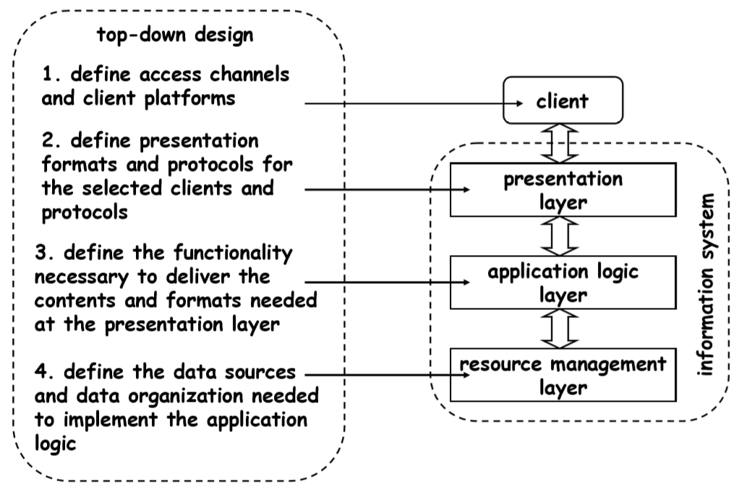
Top-Down Design

Slide 16
Bottom-Up Design
The system components and parts are designed.
The smaller parts and components of the system are then combined to achieve a higher goal.
New systems can be created by integrating existing systems.
The bottom-up approach includes:
Investigating existing applications and processes
Analyzing the problem domains
Redefining and reconstructing the problems
Determining the high-level objectives achieved by integrating these applications

Slide 17
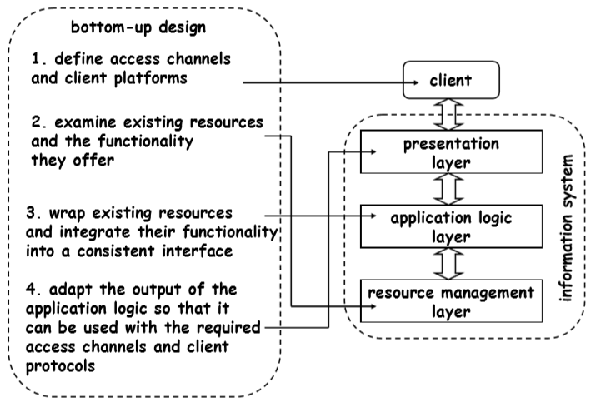
Bottom-Up Design

Slide 18
2-Tiered Architecture
The two-tier application is based on the client-server approach.
There is direct communication between the client and the server.
Client requests data from the server. Further data processing can be done on the client side.
The two-tier architecture has two main parts:
Database
Client application
Advantages:
Since there is not any intermediate layer between the client and server, the two-tier application runs faster. Business and data management are in one layer.
Disadvantages:
It supports a limited number of clients.
The server cannot respond to multiple request the same time

Slide 19
3-Tiered Architecture
In this architecture, there is an intermediate layer between presentation (user interface) and data layers.
Three separate layers:
Presentation
In this layer, the users send requests and receive data.
Business/application logic
In this layer, business rules are applied on
data calculation
data validation
data input
Data
This layer includes methods to
connect to the data resource (database)
manipulate data such as insertion, deletion, and modification

Slide 20

Entity Relationship Diagrams

Slide 21
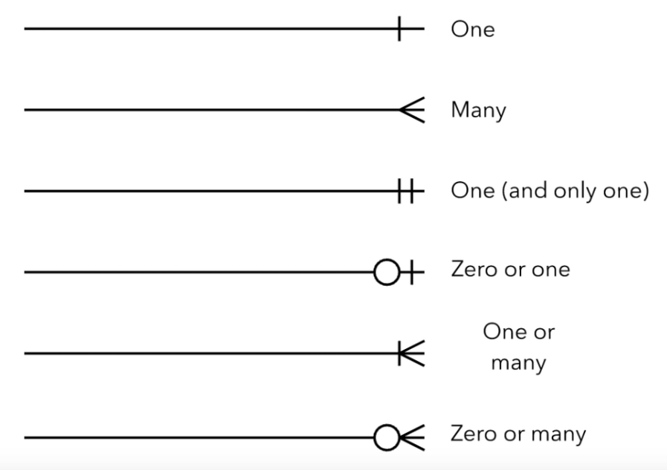
ERD Cardinality (Crow’s Foot Notation)

Slide 22
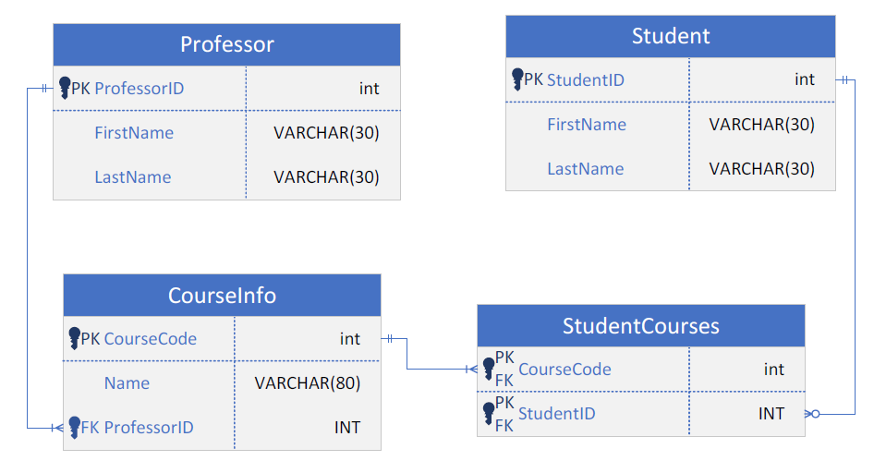
ERD Example

Slide 23
Use of ERDs
Database Design:
Model and design relational databases (logical and physical data models).
Initial step in software engineering for determining requirements.
Used to model specific databases.
Database Troubleshooting:
Analyze existing databases to identify and resolve logic or deployment issues.
Business Information Systems:
Design or analyze relational databases in business processes.
Streamline processes, improve information retrieval, and enhance results.
Business Process Re-engineering (BPR):
Analyze and model new database setups for re-engineering business processes.
Education- Plan data structures for storing and retrieving educational information.
Research - Set up databases for analyzing structured data in research projects.

Slide 24
Mapping Natural Language
Entity-Relationship (ER) Components:
Common Noun: Entity Type (e.g., student)
Proper Noun: Entity (e.g., Sally Smith)
Verb: Relationship Type (e.g., Enrolls)
Adjective: Entity Attribute (e.g., sophomore)
Adverb: Relationship Attribute (e.g., digitally)
ERROL Query Language:
Mimics natural language constructs.
Based on Reshaped Relational Algebra (RRA).
Captures linguistic aspects of ER models.

Slide 25

Summary
The Application Layers
Implementation of layered architecture
Advantages / Disadvantages
Top-Ddown Architecture
Bottom-Up Architecture
2-Tire Architecture
3-Tire Architecture
ERDs

Slide 26
Week 8
Application Modeling & Design, ERDs
Lab 6 due Monday July 8th @ 11:59pm
Quiz 6 (Transactions) opens Saturday July 6th at 8am, closes Monday July 8th at 11:59pm
Lab 7 is due Monday July 15th @ 11:59pm
Quiz 7 (Data Modeling & ERDs) will take place in Tuesday’s class.

